Slide 1

BloomView: Visualizing Floral Arrangements for Confident, Trend-Driven Purchases
Olusegun Orija

Slide 2
Project overview
The product:
App purpose: BloomView is a mobile app that allows users to preview and customize floral arrangements in augmented reality (AR) within their own space. Features include real-time customization of flower types, colors, and vase styles, along with social sharing and direct purchasing.
Target users: Busy event planners, gift shoppers, interior designers, and trend-conscious individuals seeking unique foral designs for personal or professional use.
Preview of selected polished designs.
Project duration:
May 2025 – June 2025 (1 month))

Slide 3
Project overview
The problem:
Customers struggle to visualize how floral arrangements will look in their intended space, leading to hesitation in purchasing. Additionally trendy florists lack a digital tool to showcase seasonal designs interactively.
The goal:
Create an intuitive app that enables users to preview, customize, and purchase arrangements in real-time, reducing uncertainty and increasing sales conversion for the florist.

Slide 4
Project overview
My role:
Lead UX Designer & Researcher
Responsibilities:
Conducted user interviews and competitive analysis
Designed wireframes and prototypes (low to high fidelity)
Led usabbility studies and iterated on feedback
Collaborated with developers on AR integration

Slide 5
User research
Personas
Problem statements
User journey maps
Understanding
the user

Slide 6
User research: summary
Methods: Conducted 15 user interviews, analyzed 3 competitor apps (e.g., 1-800-Flowers, Floracracy), and distributed surveys to 50 participants.
Assumptions Tested: Users prioritize speed over customization; AR would be seen as gimmicky.
Findings: Users valued customization (e.g., adjusting vase sizes) and AR previews. Speed was secondary to accuracy.

Slide 7
User research: pain points
1
2
3
Pain point
Pain point
Pain point
Unrealistic Previews: Users felt existing florist websites used generic, non-interactive images. Design Impact: Proritized AR integration with realistic lighting/shadow effects.
Complex Customization: Users found competitor tools overwhelming (e.g, too many dropdown menus). Desing Impact: Simplified UI with drag-and-drop flower selection and sliders for size/color.
Lack of Social Validation: Users wanted to share designs for feeback before purchasing. Design Impact: Added a “Share to Instagram” button in the preview screen.

Slide 8
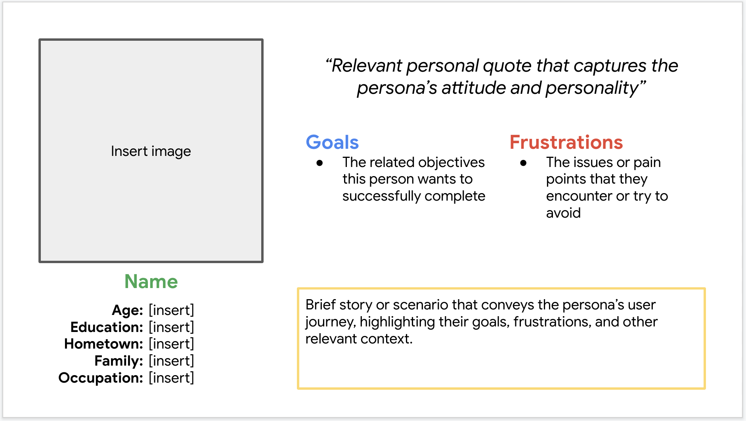
Persona: Millenial Bride-to-Be
Problem statement:
Emily is planning her wedding and wants confidence in her floral choices. A preview app helps her finalize decisions without repeat visits.

Slide 9
Persona: Trendy Small Business Owner
Problem statement:
Mateo wants to maintain the café’s visual appeal and create Instagram-worthy setups. A preview app lets him approve looks in advance.
Mateo wants to maintain the café’s visual appeal and create Instagram-worthy setups. A preview app lets him approve looks in advance.

Slide 10
Persona: Last-Minute Gifter
Problem statement:
Zoe often buys flowers for friends’ birthdays. A visual, mobile-friendly app helps her choose and send confidently, even last-minute.

Slide 11
User journey map
Key Stages: Discovery → Customization → Preview → Purchase
Emotions: Frustration (during customization) → Curiosity (testing AR) → Satisfaction (sharing final design)
Image Notes: Highlighted pain points in the “Customization” phase, leading to a streamlined toolbar in the final design.
Image of user journey map

Slide 12
Paper wireframes
Digital wireframes
Low-fidelity prototype
Usability studies
Starting
the design

Slide 13
Paper wireframes
[Your notes about goals and thought process]
Image of paper wireframes including five different versions of the same screen and one image of the new, refined version

Slide 14
Digital wireframes
Description of the element and its benefit to the user
[Your notes about goals and thought process]
Insert first wireframe example that demonstrates design thinking aligned with user research
Description of the element and its benefit to the user

Slide 15
Digital wireframes
Description of the element and its benefit to the user
[Your notes about goals and thought process]
Insert second wireframe example that demonstrates design thinking aligned with user research
Description of the element and its benefit to the user

Slide 16
Low-fidelity prototype
[Link to low-fidelity prototype and brief description of the user flow]
Screenshot of prototype with connections or prototype GIF

Slide 17
Usability study: findings
Write a short introduction to the usability studies you conducted and your findings.
Round 1 findings
Round 2 findings
1
Insert finding
1
Insert finding
2
Insert finding
2
Insert finding
3
Insert finding
3
Insert finding

Slide 18
Refining
the design
Mockups
High-fidelity prototype
Accessibility

Slide 19
Mockups
Before usability study
After usability study
[Your notes about goals and thought process]
Image of selected screen before usability study
Image of selected screen after usability study

Slide 20
Mockups
Before usability study
After usability study
[Your notes about goals and thought process]
Image of selected screen before usability study
Image of selected screen after usability study

Slide 21
Mockups
Main mockup screen for display
Main mockup screen for display
Main mockup screen for display
Main mockup screen for display

Slide 22
High-fidelity prototype
[Link to high-fidelity prototype]
Screenshot of prototype with connections or prototype GIF

Slide 23
Accessibility considerations
1
2
3
Insert one to two sentence summaries describing each accessibility consideration applied in your designs.
Insert one to two sentence summaries describing each accessibility consideration applied in your designs.
Insert one to two sentence summaries describing each accessibility consideration applied in your designs.

Slide 24
Going forward
Takeaways
Next steps

Slide 25
Takeaways
Impact:
Insert one to two sentences summarizing the impact of your designs. In the real world, you’d include data like number of downloads or sign ups, but since this is a course project, you can include a positive quote from a peer or study participant.
What I learned:
Insert a few sentences summarizing what you learned throughout the project.

Slide 26
Next steps
1
2
3
Insert a few sentences summarizing the next steps you would take with this project and why.
Insert a few sentences summarizing the next steps you would take with this project and why.
Insert a few sentences summarizing the next steps you would take with this project and why.

Slide 27
Insert a few sentences summarizing the next steps you would take with this project and why. Feel free to organize next steps in a bullet point list.
Let’s connect!
Insert a brief sentence or two about contacting you and/or reviewing more of your work.
Provide your contact information here. This might include your email address, phone number, and website or link to other professional platforms.

